Slide 1
Heart Disease Prediction Presentation
Austin Dobbins
DSC 680 Applied Data Science

Slide 2

Introduction and Background
Heart Disease in America
Who is More at Risk to Contract Heart Disease
What Needs to be Done

Slide 3
Project Goal
Overall Goal of this Project

Slide 4
Impact
What do we gain from successful completion of this project?
Impact on Americans

Slide 5
Dataset
Section of the Cleveland Heart Disease Dataset from the UCI Repository
Domain
Features Captured in the Dataset
https://archive.ics.uci.edu/ml/datasets/Heart+Disease

Slide 6
Methods Used
Python
R
Models Planned

Slide 7
Understanding the Models
Random Forest Classifier Model
Naïve Bayes Classifier
Support Vector Machine Classifier

Slide 8
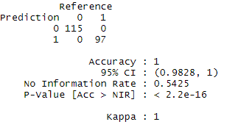
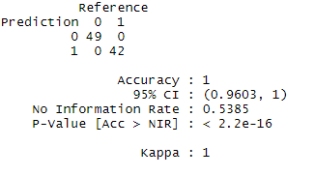
Model Results
Random Forest Classifier Results
Training and Validation Split
Results

Slide 9
Model Results
Support Vector Machine Classifier
Training and Validation Split
Results

Slide 10
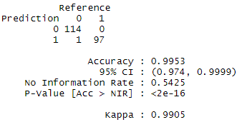
Model Results
Naïve Bayes Classifier
Training and Validation Split
Results

Slide 11
Model Selection
Model Selected
Reasoning

Slide 12
Conclusion
Successful Project?
Dataset Issues
Improvements

